Slide 1
Practical Exercises and Coursework Support
Blockchain
Coursework Assignment:
Hints and Tips

Slide 2
Assignment Tasks
Options
Choose ¾ of the following options:
Threading during Proof-of-Work
Adjusting the Difficulty Level in Proof-of-Work
Mining Settings
Your own idea
35 marks (15 for implementation and 20 for report)
Research and reference to other Blockchain implementations highly recommended for these sections.

Slide 3
Threading during Proof-of-Work
Utilise the full computational power available using:
Possible Solution: Multi-threading e.g. C# Threads
Advanced Solution: GPU implementation e.g. CUDA C
Requirements:
E-Nonce (Prevent duplication of work)
Coordination of threads
Reporting Suggestion:
You can perform a comparison study comparing mining times of single- vs. multi-threaded solution
Vary difficulty level to examine the point at which overheads are overcome

Slide 4
Adjusting the Difficulty Level in PoW
“Dynamic” or “Adaptive” Difficulties
Decide your own ‘block time’ and implement an appropriate algorithm
Principles and Requirements
Establish a target block time
Continuously call Mine()
Calculate the “Mine Rate” based on previous block timestamps
Adjust the difficulty based on the difference between target and actual/observed block time
Note the current implementation adjusts difficulty by a factor of 16 with each step which you may find to be too significant – consider alternative solutions.

Slide 5
Adjusting the Difficulty Level in PoW
Starting off:
Need to have revised thread management in C#
Please refer to the notes already provided
Can start with a moderate level of difficulty say 5 and
Now you need to benchmark this i.e. measure how long it takes with or without threads and how many threads to satisfy a workable level of difficulty and block time
This just means repeating the PoW using Mine() for different levels of difficulty with or without threads
Block time = timestamp for block (n) – timestamp for block (n-1)

Slide 6
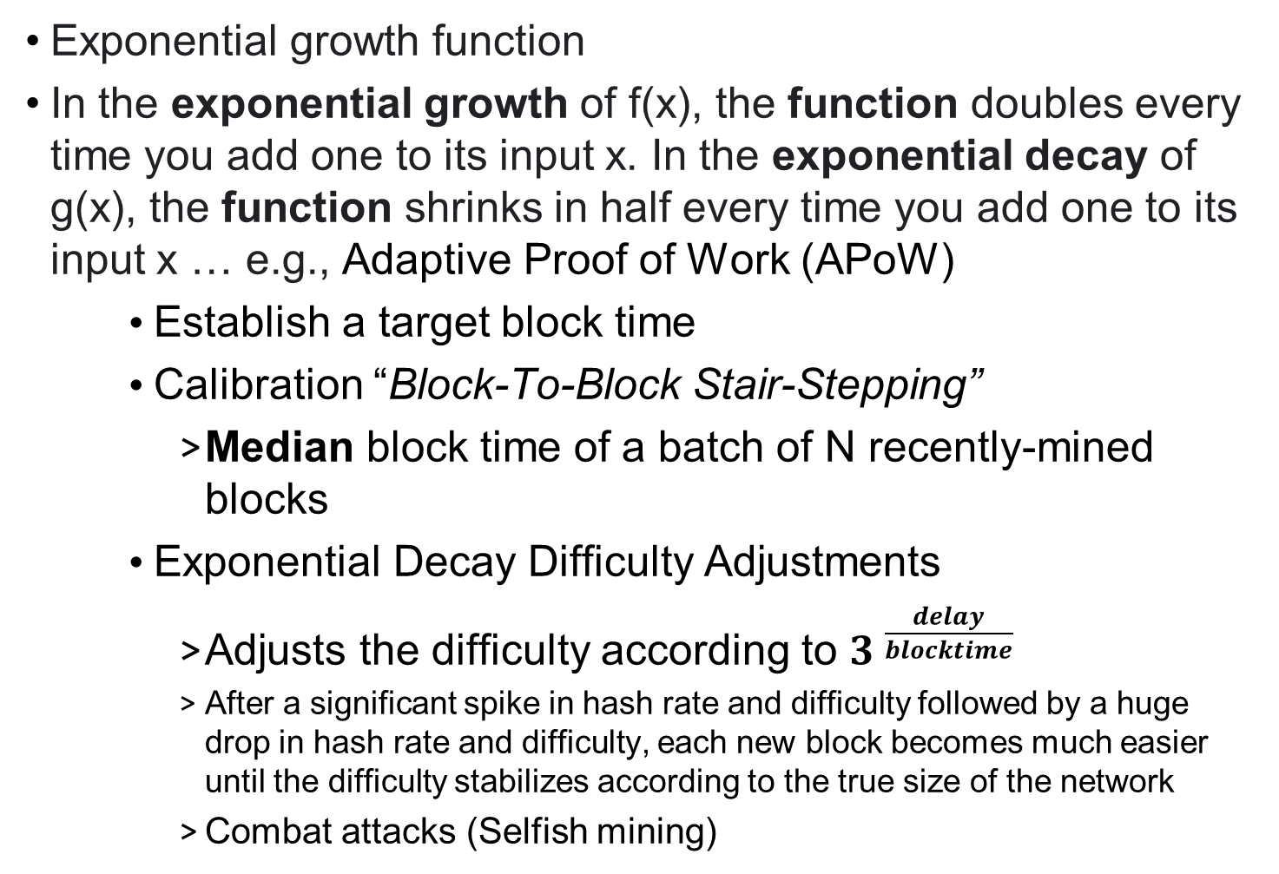
Adjusting the Difficulty Level in PoW
Exponential growth function
In the exponential growth of f(x), the function doubles every time you add one to its input x. In the exponential decay of g(x), the function shrinks in half every time you add one to its input x … e.g., Adaptive Proof of Work (APoW)
Establish a target block time
Calibration “Block-To-Block Stair-Stepping”
Median block time of a batch of N recently-mined blocks
Exponential Decay Difficulty Adjustments
Adjusts the difficulty according to ${3 }^{\frac{delay}{blocktime}}$
After a significant spike in hash rate and difficulty followed by a huge drop in hash rate and difficulty, each new block becomes much easier until the difficulty stabilizes according to the true size of the network
Combat attacks (Selfish mining)

Slide 7
Mining Settings
Selection of pending transactions for mining
Possible Options:
Greedy (Largest fees)
Unpredictable (Random)
altruistic (Oldest existing)
Address based (Personal transactions)
This just requires
i) Use the existing code to create many transactions with variable amounts and fees
i) Write code to deliver that is to select the right transactions from the transaction pool in each of the 4 case
ii) Using the Windows Form to create the 4 buttons that would select and display the right number of transactions up to a stated limit according the selection strategies 1-4 above.

Slide 8
Your own idea
Possible Suggestions
1) Implementation of a different consensus algorithm (e.g. Proof-of-Stake)
2) Create multiple nodes running in a local network, automating the generation of transactions.
3) (Advanced) Smart Contracts

